Slide 1

Luxury Housing Analysis
Kanimozhi

Slide 2
Introduction:
Objective of the analysis:
Understand market trends in luxury housing
Identify top developers/projects
Analyze buyer behavior and booking patterns
Dataset Overview:
Columns used:
Project_ID, Micro_Market, Builder, Ticket_Price_Cr, Configuration, Possession_Status, Amenity_Score, Booking_Status, Purchase_Quarter, Sales_Channel, Buyer_Type, Buyer_Comments

Slide 3
Trends and pricing
Market trends
Pricing insights
Growth in luxury housing bookings
(Quarterly trend line)
Concentration in key micro-markets
(Map chart)
Average ticket price by configuration
(2BHK, 3BHK, 4BHK, etc.)
Price per sqft analysis (bar/column chart)

Slide 4
Developer Performance
Top 5 developers by:
Revenue
Booking success rate
Card Visuals for Top 5 Developers

Slide 5

Buyer Insights
Buyer type and Possession status distribution-Clustered column chart
Booking status and Configurations-Pie chart
Along with the configuration 5BHK+ filled highest rate
Market shows steady growth across quarters
Along with Market growth Quarter 2 growth increase as compared to previous Quarter
According to the sales channel Online sales reached highest place.

Slide 6
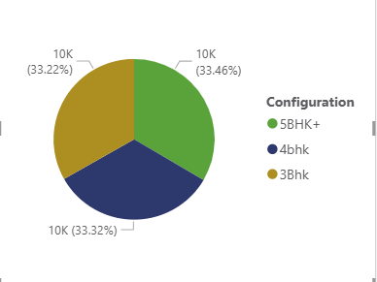
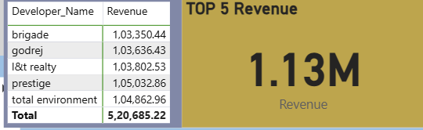
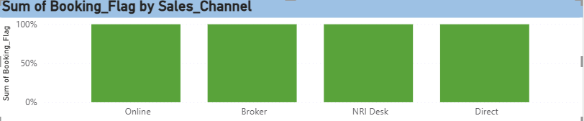
Power BI Visualization

Slide 7
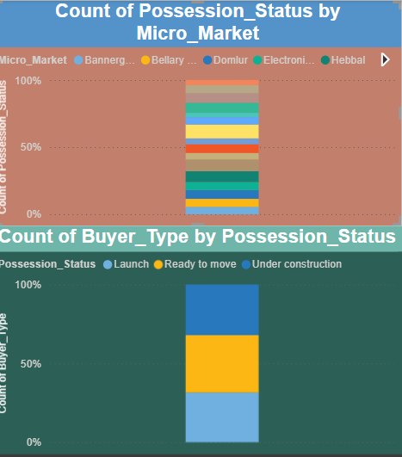
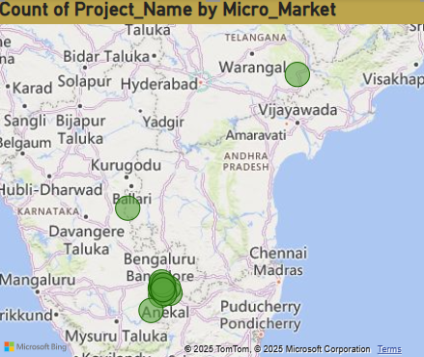
Map Visual

Slide 8
Thank you

